Slide 1
LOAN MANAGEMENT AND RISK ANALYTICS IN FINANCIAL INSTITUTIONS

Slide 2
Introduction
Loan management is an essential aspect of banking that plays a crucial role in ensuring the stability and profitability of financial institutions. A loan management system enables the lenders to seamlessly manage the loan lifecycle, centralizes data, enhances communication and accelerates decision making and significantly improving operation efficiency.
This case study aims to give us an idea of applying Expository Data Analysis in a real business scenario and understand how data is used to minimize the risk of losing money while lending to customers.
Power BI was used for analysis in this project and the dataset used can be found here: www.kaggle.com/datasets/aungpyaeap/supermarket-sales.

Slide 3
Key Column Definition
Sk ID Curr: Identity of applicants
Target: Clients with payment difficulty.
Contract type: Type of loan applied for.
Gender: Whether male or female.
Flag own car: Whether applicant own a car or not
Flag own reality: Whether applicant own a building or not.
Name Income type: Source of income of applicants.
Name Education type: Level of highest education the client achieved.
Occupation type: What kind of occupation does the client have?
Weekday Appr Process Start: On which day of the week did the client apply?

Slide 4
Data Cleaning and Preparation
Import the dataset through the link provided above into Power BI and transform data. There are few adjustments we will be making to this data as listed below:
The values in the columns of Days birth, days employed, days registered and days ID were published as negative values but have now been changed to absolute values for ease of analysis.
Some columns were deleted because they contained so many missing values and null values.

Slide 5
Objective
To analyze the risk level taken by financial institutions in giving out loans to applicants taking into consideration various information provided by applicants.

Slide 6
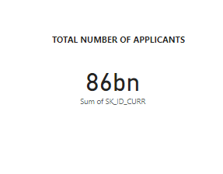
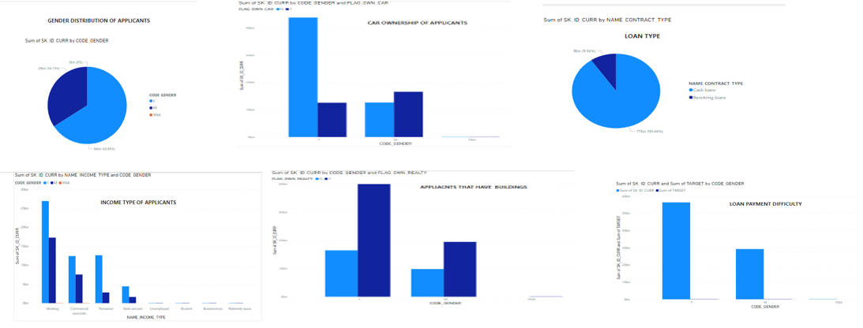
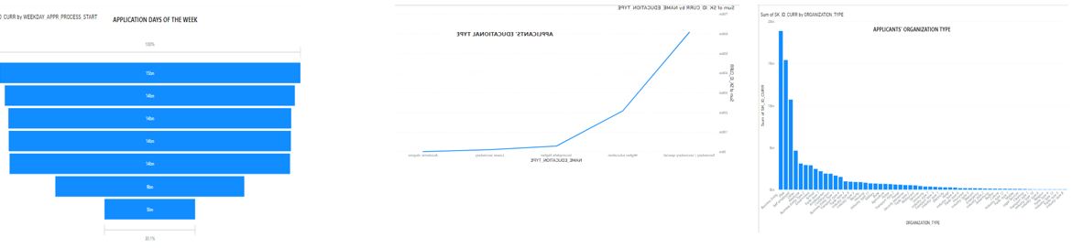
Dashboard

Slide 7
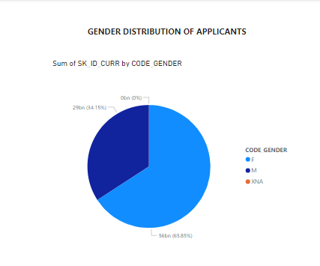
Data Exploration
Gender Distribution
Of the 86billion people that applied for loan, 65.9% are females whereas 34.1% are males.

Slide 8
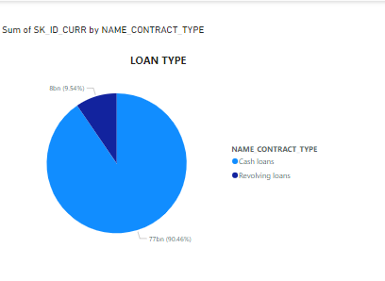
Loan Type
Most applicants applied for cash loan than revolving loan. 90.46% of the applicants went for cash loan whereas the other 9.54% went for revolving loan. This can be so probably because the use of credit cards which is associated with revolving loans is not common in that geographical area.

Slide 9
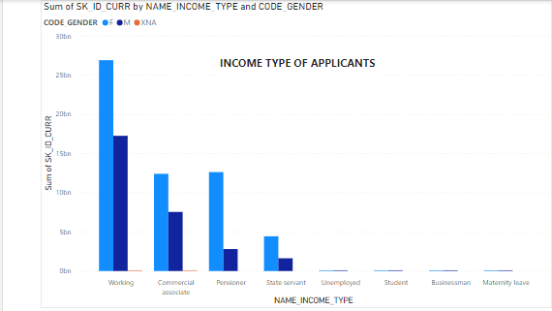
Income Type
Applicants’ source of income is of paramount interest to the financial institution. Those who are working top the chart of applicants followed by those who are financial associates. Those who applied for loan because they are on maternity leave are least among the applicants.

Slide 10
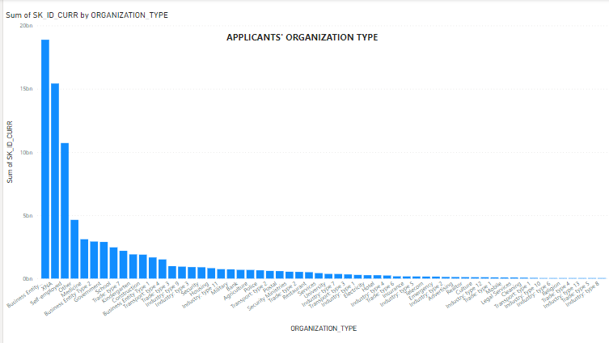
Organizational Type
Among the applicants, those who work in business organizations are the highest, followed by those whose organizational type are not captured. Those who are in the industry type 8 are least among the applicants.

Slide 11
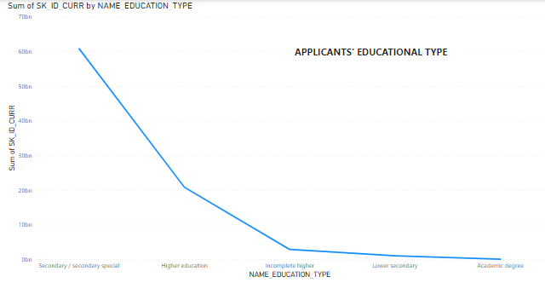
Academic Background
From the chart below, we can comfortably say applicants are not illiterates which makes it easy for them to fill their forms correctly. They have attained various forms of education. Those with secondary education are more whereas those with university degree are least among applicants.

Slide 12
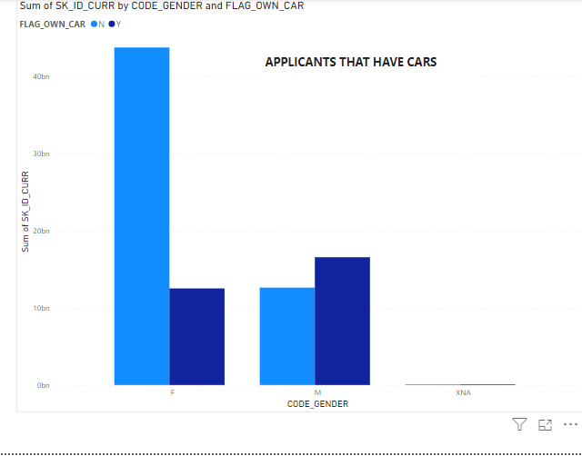
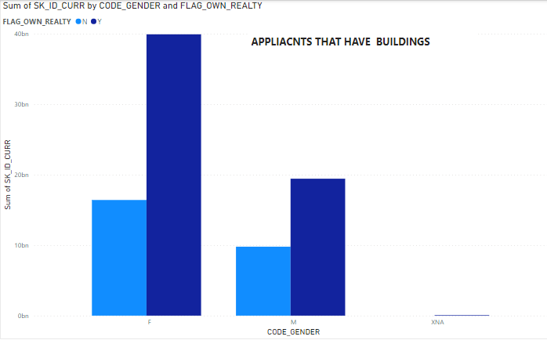
Properties ownership of Applicants
The bar chart below shows the number of applicants that have either a car or a building or both.
It can be observed that the women without cars are almost equal to those that have buildings whereas those that have cars among the men are moderately less than those with buildings and same with those without cars or buildings.

Slide 13
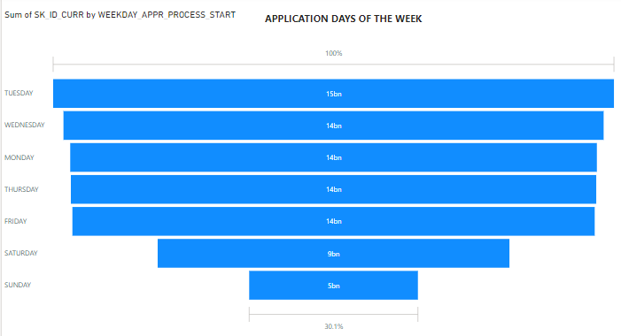
Application Time of the Week
The chart captures that the financial institution worked throughout the week to allow applicants apply for loan.
It can be seen that more applications were received on Tuesday followed by Wednesday. Saturday recorded a low turnout followed by Sunday with the lowest turnout in applications.

Slide 14
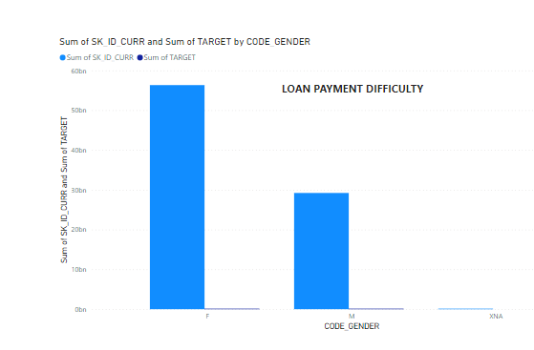
Applicant’s Difficulty in paying back Loan
The ultimate goal of any financial institution is for their loans to be paid back within time frame. When payments are delayed, cash flow can turn negative and the institution may have to take drastic measures to raise funds to cover operating cost.
From the chart above, more applicants of both genders have very low level of difficulty in paying back their loans which is to the institution’s advantage.

Slide 15
Conclusion
The analysis shows that majority of the applicants can easy pay back their loans. The number of applicants having difficulty in paying back is infinitesimal. We can therefore say, the financial institution is not at risk with the loans given out.

Slide 16
Recommendations
From the analysis, it can be observed that more females have applied for loan than their male counterparts. Sensitization programs should be carried out to encourage more males in applying for loans within their reach.
Prospective applicants should be should enlightened on the benefits of taking loans which include business startups, business support, carrying out projects like building a house etc. which ordinarily their incomes alone cannot finance.
Financial institutions should make their loans more flexible and with incentives for those who are able to pay up their loans within time frame.

